Slide 1
Greek Tragedy and Aristotle’s Poetics
Introduction to English Literature 04, June 4, 2024

Slide 2
Greek Tragedy:
Origin: the art of drama developed in the ancient Greek city-state of Athens in the late sixth century B.C. From the religious chants honoring Dionysus arose the first tragedies, which centered on the gods and Greece’s mythical past.
Three tragedians in the fifth century: Aeschylus, Sophocles, and Euripides.
Themes: the good and evil that existed simultaneously in the world as well as the other contradictory forces of human nature and the outside world.

Slide 3
Sources
All three tragic playwrights drew their material from Greek myths and legends; they each brought new developments to the art form. Aeschylus, whose Oresteia trilogy examines the common tragic themes of vengeance and justice, brought tragedy to the level of serious literature. Sophocles wrote perhaps the greatest tragic work of all time, Oedipus the King. The last great tragedian, Euripides, questioned traditional values and the ultimate power of the gods. In plays such as Medea, Euripides explores the choices that humans make under difficult situations.

Slide 4
C. M. Bowra in his Classical Greece
“Greek tragedy provides no explicit answers for the sufferings of humanity, but it . . .shows how they happen and how they may be borne.”

Slide 5
Paul Roche in The Orestes Plays of Aeschylus
“The theme of all tragedy is the sadness of life and the universality of evil...The inference the Greeks drew from this was not that life was not worth living, but that because it was worth living the obstacles to it were worth overcoming.”

Slide 6
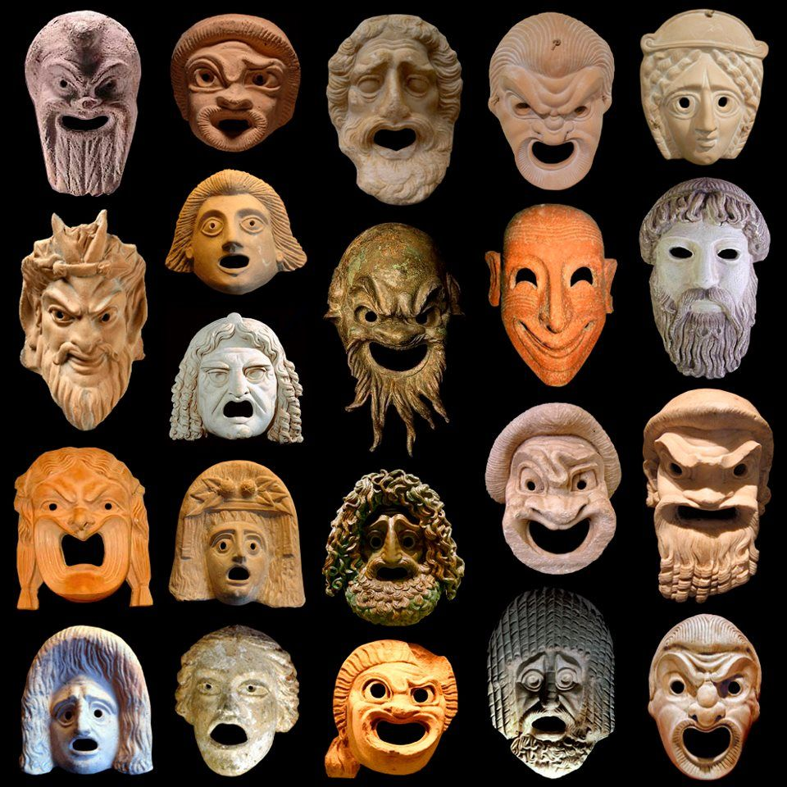
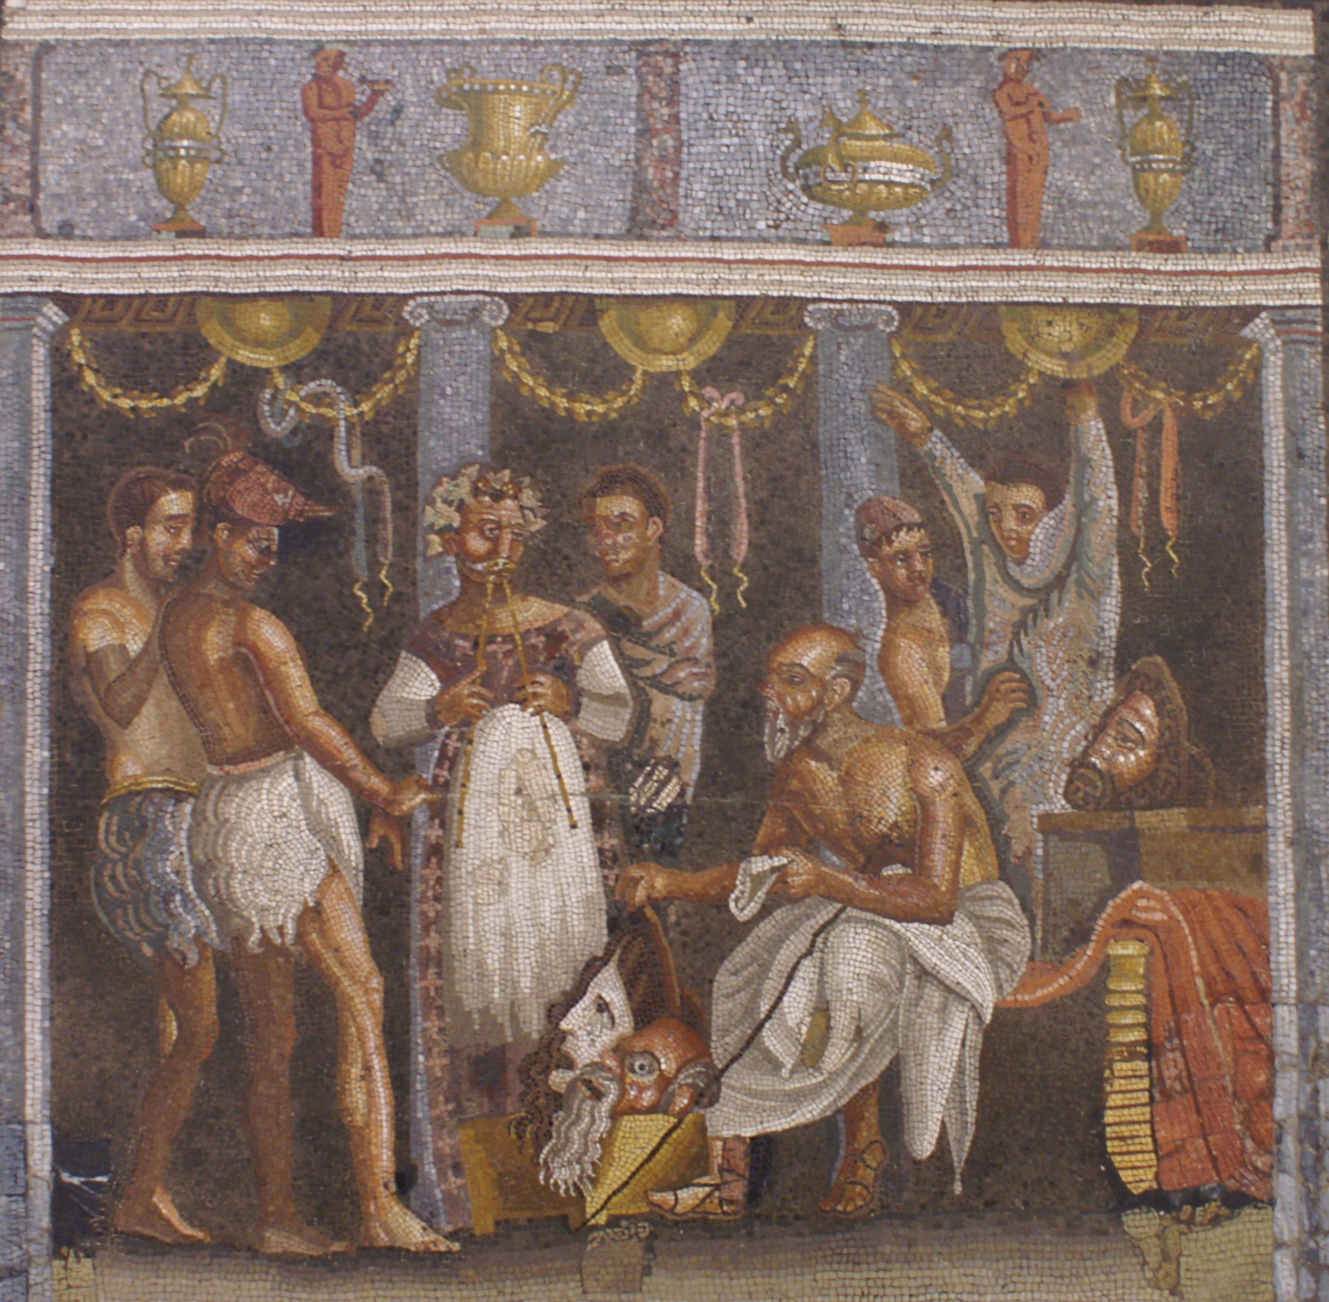
Masks in Greek Theater

Slide 7
Masks in Greek Theater
Actors wore masks so that the audience may see the facial expression clearly, allow them to tell the characters apart and make the theme of the story (comedy or tragedy) clearly obvious to the spectators. The actors needed to make sure they made exaggerated body movements so that the audience could understand what was happening, and they also needed to project their voices as the mask might have effected how loud their voices could be heard. When actors were switching roles, they needed to be careful, when changing masks to not show the spectators their actual face and the roles being switched. They would face to the back of the skene and put on the mask.

Slide 8
Mythology and the Gods
The ancient Greeks believed that tragedy should deal with illustrious figures and significant events, thus the pantheon of gods is ever-present and, often, omniscient. Aeschylus’ plays, for instance, often centered on the justification of the gods’ ways in relation to humankind or the comprehension of the form of justice meted out by the gods. The gods might punish the characters, as Zeus punished Prometheus in Prometheus Bound, or they might settle the seemingly insurmountable conflicts the characters faced, as when Athena decreed that the Furies must give up their torment of Orestes in the Oresteia. The tragedians took the basic premise of their stories from mythology but transformed them for dramatic intent, infusing the heroes and heroines with human qualities and relating their themes to the present day. Mythology also lent the tragedians’ plays a more universal quality, allowing them to comment on topical events without limiting their scope to contemporary events and figures.

Slide 9
Aristotle's Poetics
Aristotle’s Poetics, though short, has been widely influential outside philosophical circles. Yet it is doubtful that it can be fully appreciated outside Aristotle’s philosophical system as a whole. Central to all Aristotle’s philosophy is the claim that nothing can be understood apart from its end or purpose(telos). Not surprisingly, The Poetics seeks to discover the end or purpose of all the poetic arts, and especially of tragic drama.

Slide 10
The Goal of Poetry
Understood generally, the goal of poetry is to provide pleasure of a particular kind. The Metaphysics begins, “All men desire to know by nature,” and the Nicomachean Ethics repeatedly says that the satisfaction of natural desires is the greatest source of lasting pleasure. Poetics combines these two with the idea of imitation.

Slide 11
The Effect of Tragedy
Of particular interest to Aristotle is the pleasure derived from tragic drama, namely, the kind of pleasure that comes from the purging or cleansing (catharsis) of the emotions of fear and pity. Though the emotions of fear and pity are not to be completely eliminated, excessive amounts of these emotions are not characteristic of a flourishing individual. Vicariously experiencing fear and pity in a good tragedy cleanses the soul of ill humors.

Slide 12
The importance of the Plot
For a plot to work, it must be both complete and coherent. That means that it must constitute a whole with a beginning, middle, and end, and that the sequence of events must exhibit some sort of necessity. A good dramatic plot is unlike history. History has no beginning, middle, and end, and thus it lacks completeness. Furthermore, it lacks coherence because many events in history happen by accident. In a good dramatic plot, however, everything happens for a reason. This difference makes tragedy philosophically more interesting than history.

Slide 13
Literary Terms on Tragedy from Poetics I
Catharsis: "purgation" or "purification" in Greek. Many tragic representations of suffering and defeat leave an audience feeling not depressed, but relieved, or even exalted.
Tragic Hero: neither thoroughly good nor thoroughly bad but a mixture of both, and "better than we are" with higher moral worth.

Slide 14
Literary Terms on Tragedy from Poetics II
Hamartia(tragic flaw): suffering a change in fortune from happiness to misery because of his mistaken choice of an action, to which he is led by his hamartia—his "error of judgment" or, as it is often though less literally translated, his tragic flaw.
Hubris(Pride): (One common form of hamartia in Greek tragedies was hubris, that "pride" or overweening self-confidence which leads a protagonist to disregard a divine warning or to violate an important moral law.

Slide 15
Literary Terms on Tragedy from Poetics III
Anagnorisis: discovery of facts hitherto unknown to the hero.
Peripeteia: or reversal in his fortune from happiness to disaster.

Slide 16

The End

